Slide 1
Restoration: A Historical Perspective

Slide 2
⁴⁴“And in the days of these kings the God of heaven will set up a kingdom which shall never be destroyed; and the kingdom shall not be left to other people; it shall break in pieces and consume all these kingdoms, and it shall stand forever. ⁴⁵“Inasmuch as you saw that the stone was cut out of the mountain without hands, and that it broke in pieces the iron, the bronze, the clay, the silver, and the gold—the great God has made known to the king what will come to pass after this. The dream is certain, and its interpretation is sure.” - Daniel 2:44,45 NKJV

Slide 3
Jesus Taught:
Mark 9:1 – Some Standing Here Will Not Taste Death Before The Kingdom Comes
Matthew 16:13-19 – “Upon This Rock I Will Build My Church . . . And I Will Give Unto You The Keys Of The Kingdom Of Heaven”

Slide 4
On The 1st Day Of Pentecost
Prophecy Fulfilled
vv.16-21 – Joel 2 – God’s Great And Notable Day
vv. 25-28 – Psalm 16:8-11 – David’s Prophecy
Church Starts – v.38-40
Kingdom Rule Begins Thru Apostles’ Binding Authority, cf. v.42-47 with Matthew 16:18,19

Slide 5
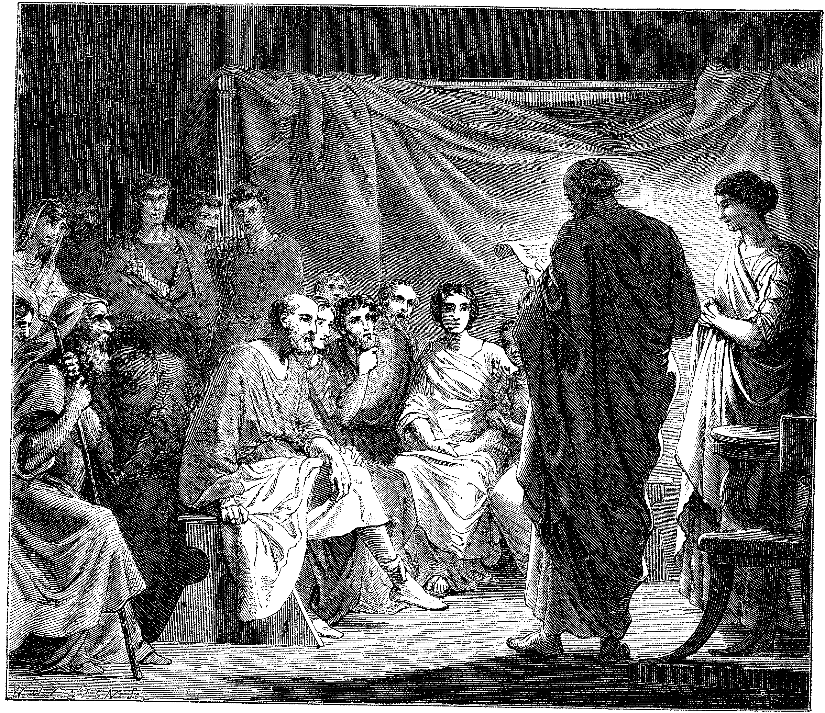
Problems In The Church Required Letters
1 & 2 Corinthians
Disunity Through Partyism
Taking Brothers To Law
Incest
Denial Of The Resurrection, etc.
Colossee – Mysticism, Gnosticism
Revelation – 7 Churches – With Problems
Acts 20:28ff – Paul’s Warnings

Slide 6
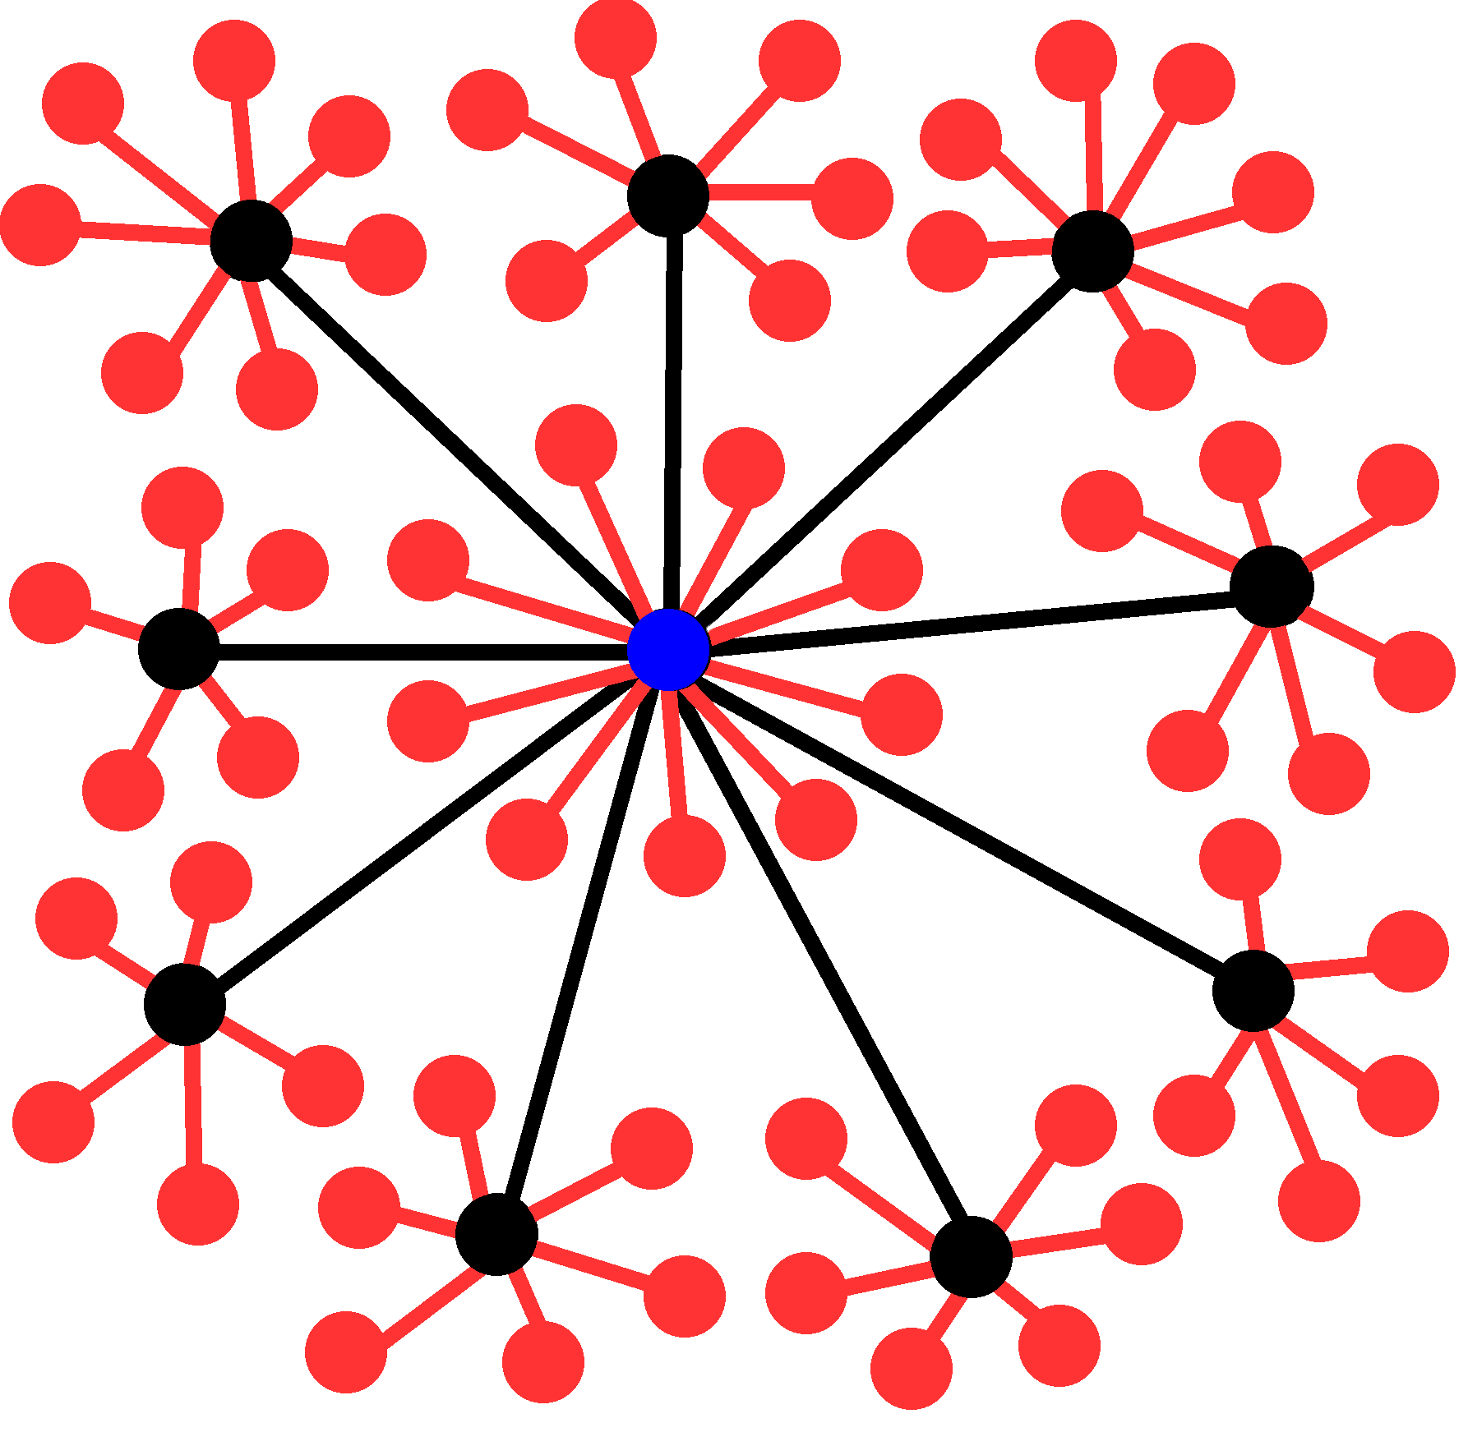
Roman Church Development

Slide 7
Departures
175 A.D. – It Was Written That A Bishop Was Different From An Elder, One Bishop Over Elders
250 A.D. – Development Of One Bishop Over Diocese
606 A.D. – Boniface III – First Universal Head – Pope
580 A.D. – Attempts To Add Instruments To Worship Were Rejected
660 A.D. – Pope Vitalian Introduced Organs In The Church, but not generally used at that point in time.
Pope
Cardinals
Archbishops
Bishops
Priests
Deacons
Notes:
Roman Catholic Church Hierarchy
The Catholic clergy is organized in a strict, sometimes overlapping hierarchy:
Pope: Head of the church, he is based at the Vatican. The pope is infallible in defining matters of faith and morals.
Cardinal: Appointed by the pope, 178 cardinals worldwide, including 13 in the U.S., make up the College of Cardinals. As a body, it advises the pope and, on his death, elects a new pope.
Archbishop: An archbishop is a bishop of a main or metropolitan diocese, also called an archdiocese. A cardinal can concurrently hold the title. The U.S. has 45 archbishops.
Bishop: A bishop, like a priest, is ordained to this station. He is a teacher of church doctrine, a priest of sacred worship, and a minister of church government. The U.S. has 290 active bishops, 194 head dioceses.
Priest: An ordained minister who can administer most of the sacraments, including the Eucharist, baptism, and marriage. He can be with a particular religious order or committed to serving a congregation.
Deacon: A transitional deacon is a seminarian studying for the priesthood. A permanent deacon can be married and assists a priest by performing some of the sacraments.

Slide 8
After 1000 A.D. – Dark Ages
By 1100 – Papal Customs, e.g. Holy Water Introduced
By 1200 – Baptism By Sprinkling
A Few Years Later, Sprinkling Dead Infants
A Few Years Later, Prayer Thru Mary
She Was Deified In 1967
1290 A.D. – Marinus Sanutus Added Wind Organs Into Churches, — McClintock & Strong vol. 8, p.739
Only Clergy Had The Bible, No Personal Interpretation Allowed

Slide 9
The Johannes Gutenberg Printing Press - 1454
Arguably History’s Greatest Invention
Produced In Mainz, Germany
First Produced Book: The Bible

Slide 10
The Age Of Enlightenment & The Reformation
John Wycliffe – 1329-1384, English Reformer
Jan Hus – 1373-1415, Prague, Czechoslovakia
Martin Luther – 1483-1546, Germany
Girolamo Savonarola – 1452-1498, Florence, Italy
William Tyndale – 1494-1536, English Reformer
Ulrich Zwingli – 1484-1531, Geneva, Switzerland
John Calvin – 1509-1564, Another Swiss Reformer

Slide 11
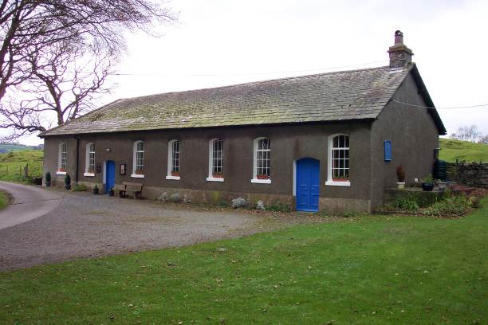
Tottlebank Church
A Church of Christ
-Early As 1669

Slide 12
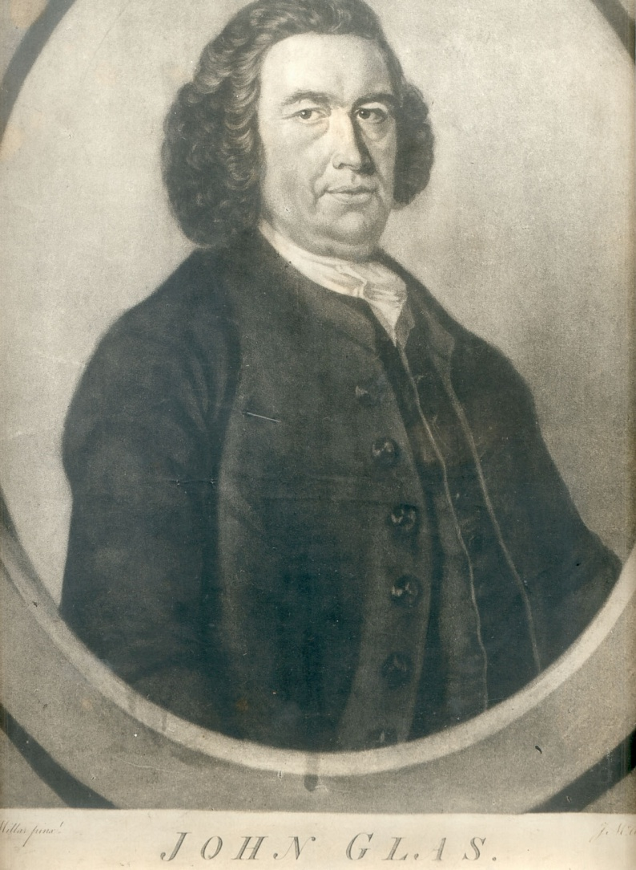
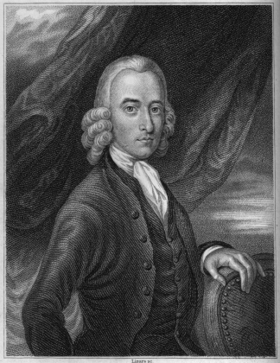
John Glas 1695-1773
Fathers Of Congregationalism
Robert Sandeman 1718-1771

Slide 13
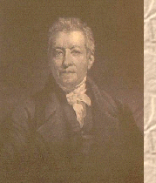
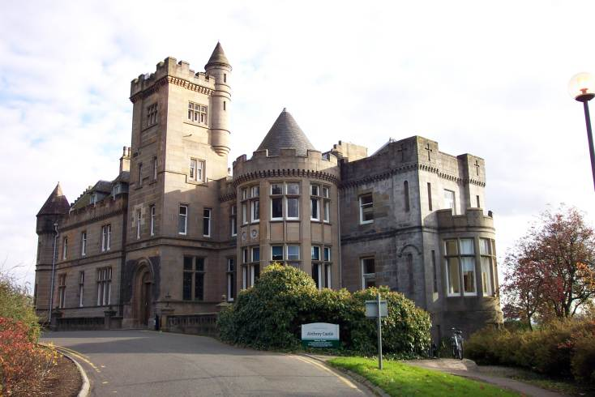
Robert & James Haldane
Baptist Ministers Who Brought About Reform In The British Isles
James Haldane 1768-1851

Slide 14
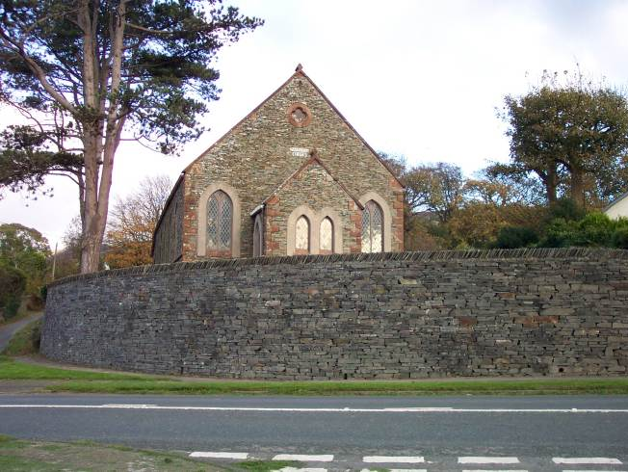
Kirkby Church of Christ
By 1824 a church after the ancient order was serving the Lord at Kirkby.
It was 30 years before any hear of Barton W. Stone or Alexander Campbell

Slide 15
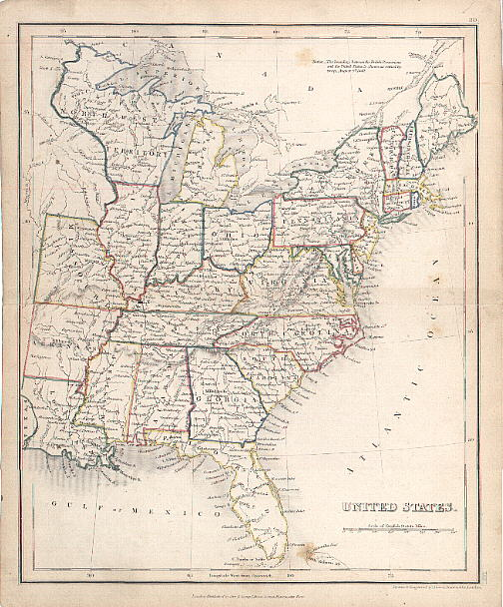
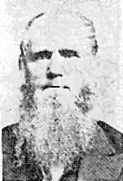
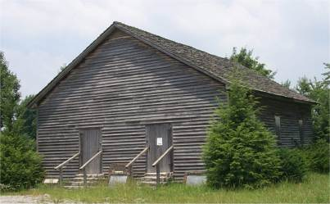
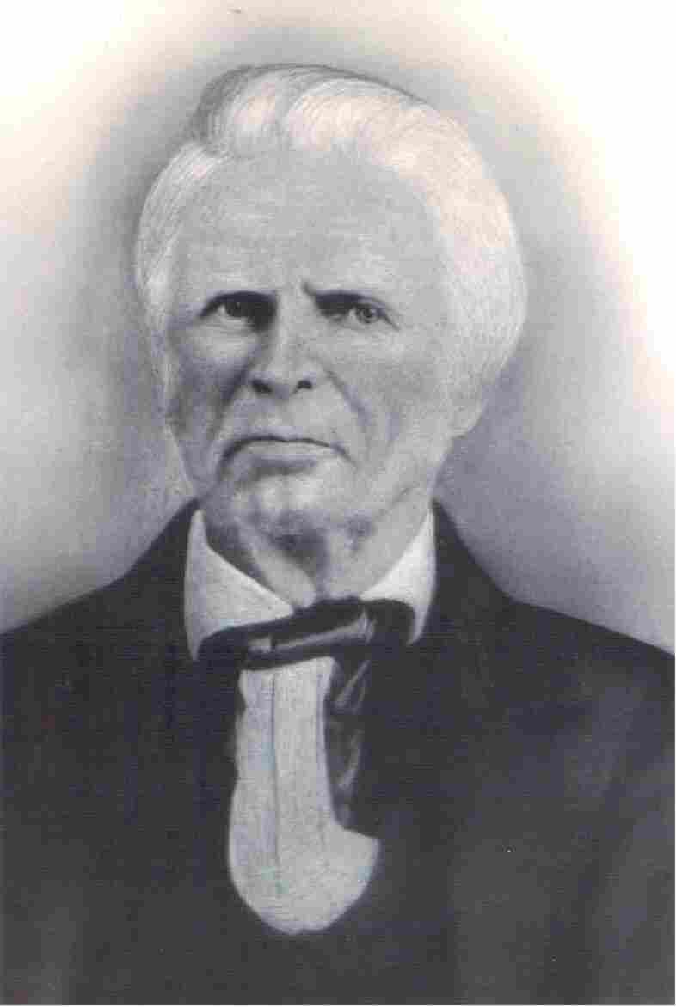
Movements Independent Of Stone & Campbell Part II
Old Philadelphia
Warren Cty. TN
Dr. Chester Bullard
1809-1893
1805
John Taylor
Christian H. Dasher
1807-1895
1789-1866

Slide 16
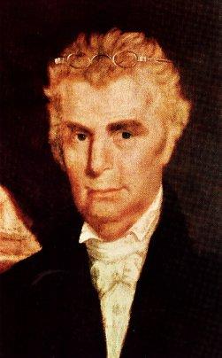
The Work And Influence Of Barton W. Stone

Slide 17
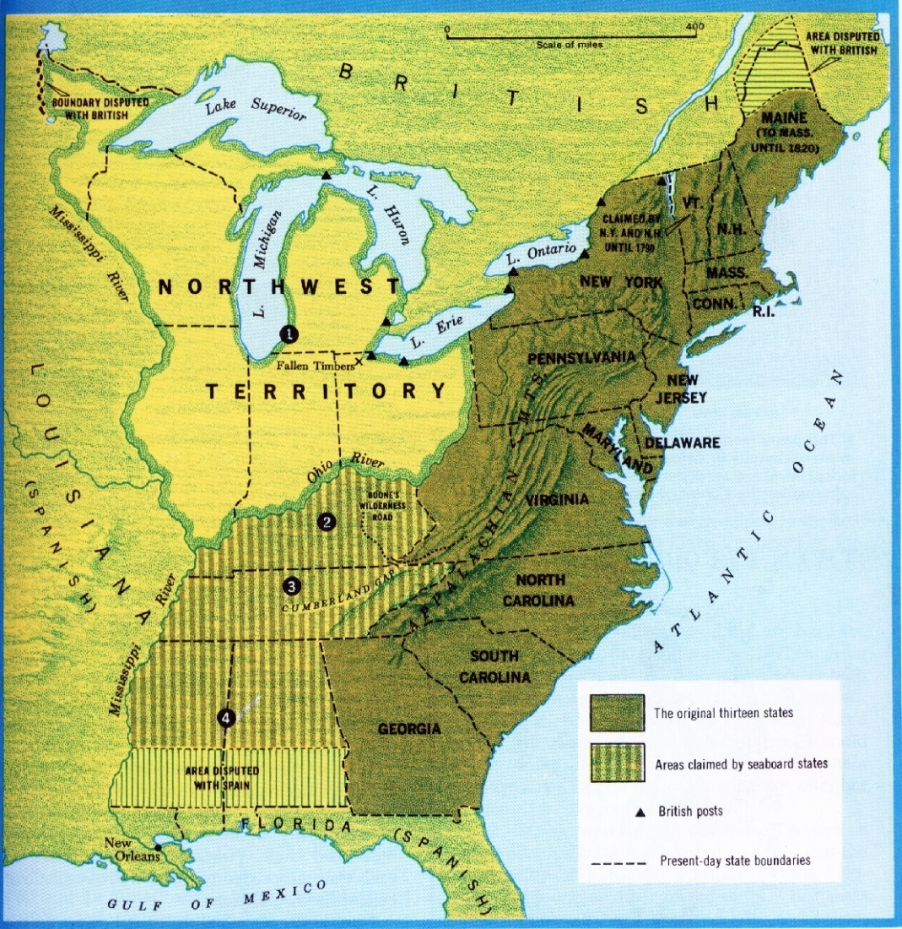
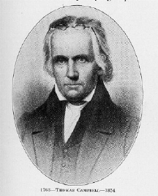
The Influence Of Thomas & Alexander Campbell
1809, Thomas & Alexander Campbell, Bethany, Virginia
Thomas Campbell 1763 - 1854

Slide 18
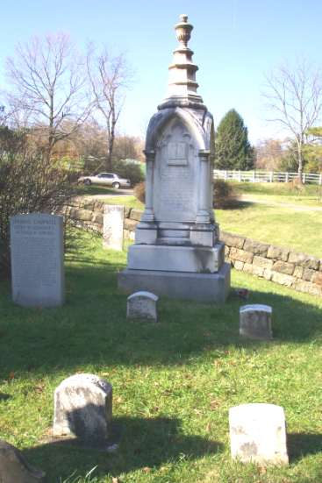
Alexander Campbell 1788-1866

Slide 19
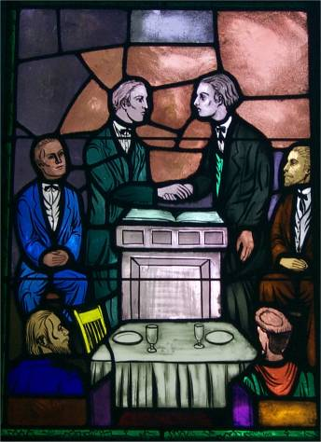
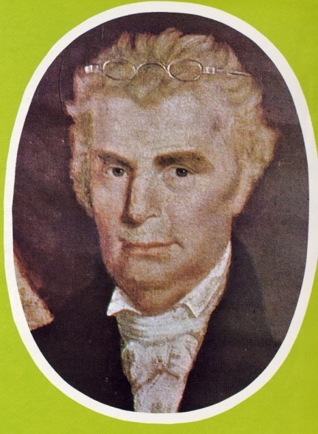
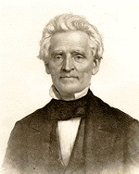
Coming Together Of A Movement
Meeting Of Stone’s Christians & Campbell’s Disciples At Hill Street Church In Lexington, Last Week In 1831
January 1, 1832 Joined Forces With A. Campbell’s Disciples Movement
“Let us, then my brethren, be no longer Campbellites or Stoneites, New Lights or Old Lights, or any other kind of lights, but let us come to the Bible, and to the Bible alone, as the only book in the world that can give us all the light we need.” — John Smith
Hill Street Church, Lexington, Kentucky
“Raccoon” John Smith

Slide 20
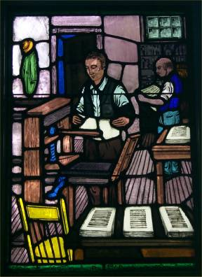
The Printing Press Contributed To Union
B.W. Stone’s 1826 Christian Messenger
A. Campbell’s 1830 Millennial Harbinger
Tolbert Fanning’s 1855 Gospel Advocate
Austin McGary’s 1884 Firm Foundation

Slide 21
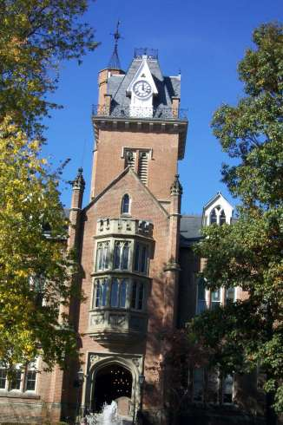
Christian Education
1834 – Bacon College, Georgetown, Kentucky
1840 – Bethany College, Virginia
1843 – Franklin College, Tennessee
1869 – Henderson, Tennessee, Henderson Male & Female Institute Begins, Root School Out Of Which Would Later Come Freed-Hardeman University
1891 – Nashville Bible School Begins, Later Lipscomb University

Slide 22
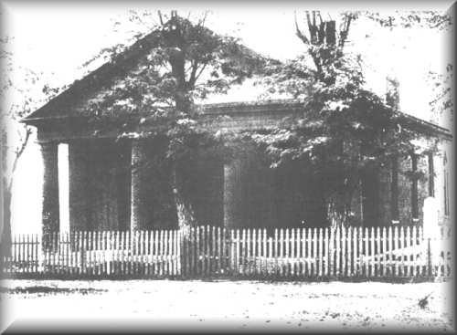
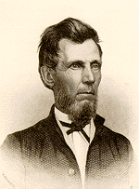
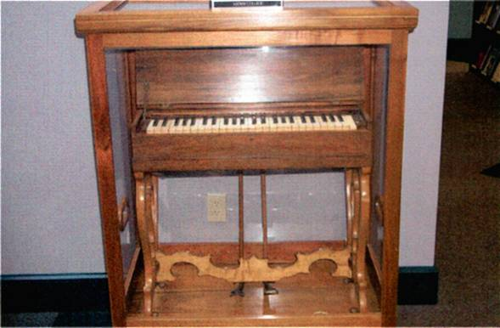
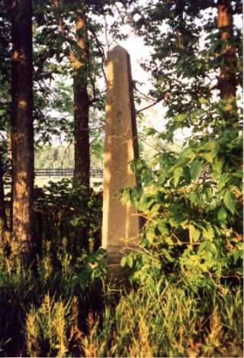
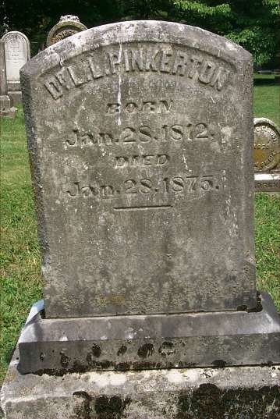
Divisions: 1860 Addition Of The Instrument
Adam Hibler Grave
L.L. Pinkerton Grave

Slide 23
Other Things Contributing To Division
American Christian Missionary Society – 1849
The Civil War – 1861-1865
1866 Christian Standard Begins With Isaac Errett As Editor – Devoted To A More Progressive Approach To Christianity
1906 – U.S. Census Records Distinction Between Christian Church & Churches Of Christ

Slide 24
Splintering Continues In The 20th Century
March, 1917 Major Controversy In The College Of The Bible Exists Over The Subject Of Evolution & Higher Criticism, Leading To A Split In Christian Church, Enter: The Disciples Of Christ
1920s Controversies With R.H. Boll Over Premillennialism
1930s & 40s Relative Quietness Due To Economic Depression & War
1950s To 1970s Battles Over Support Of Institutions/Sunday School/Located Preachers/Christian Colleges/etc.
1980 To Today – The Change Movement – New Hermeneutics/Worship Styles etc.

